Slide 1
IBM University Engagement Project Submission
“Exploring the Power of Agentic AI with IBM Granite”

Slide 2
Project Tile – GreenPulse AI – Agentic Renewable Energy Intelligence Platform
Domain of Project – Energy & Sustainability
Student Name | Recent Passport Photo | Email ID | Mobile number [WhatsApp]
Yash Kayasth |  | Kyt47000@gmail.com | 7201862574

Slide 3
Problem Statement
Problem Statement : Smart Renewable Energy (Solar-Wind Hybrid) Asset Monitoring for Kutch & Banaskantha
Domain: Energy & Sustainability
The Challenge
Gujarat leads India in hybrid solar-wind renewable capacity, particularly in Kutch and Banaskantha, but scattered installations face inefficiencies from inconsistent maintenance scheduling, underperformance detection, and grid integration challenges.
The Objective
Develop Agentic AI solutions that monitor renewable asset performance, predict maintenance needs, and optimize grid integration for hybrid energy parks.

Slide 4
Proposed Solution -
Proposed Solution: GreenPulse AI – Agentic Renewable Energy Intelligence Platform The proposed solution is an Agentic AI-powered renewable energy monitoring and optimization platform built using IBM Granite, IBM Cloud, IoT, SCADA and intelligent AI agents to provide centralized, proactive, and data-driven management of solar and wind assets across Kutch and Banaskantha. The system can collect real-time field data through IoT sensors, SCADA systems, smart meters, weather stations, inverters and wind-turbine controllers, and process it through a cloud-based AI platform. The solution consists of five specialized agents: Asset Performance Monitoring Agent detects underperforming assets and anomalies; Predictive Maintenance Agent analyzes equipment health and maintenance requirements; Weather-Based Generation Forecasting Agent predicts solar and wind generation; Grid Integration Optimization Agent recommends efficient power export, storage and curtailment actions; and the Renewable Energy Dashboard Agent combines insights from all agents and provides actionable recommendations to operators. At the ground level, required hardware includes solar irradiance, temperature, humidity, wind-speed and wind-direction sensors, turbine vibration and RPM sensors, power/energy meters, inverter monitoring units, smart meters, IoT gateways and edge controllers, along with existing SCADA infrastructure. Required software and cloud tools include IBM Granite/watsonx.ai, IBM Cloud, IoT data pipelines, databases, APIs, analytics services, React-based dashboards and an agent orchestration framework. Currently, the data and asset values shown in the application are mock/simulated data created only for prototype and hackathon demonstration purposes; they are not live readings from actual renewable-energy installations. In a real-world deployment, the platform would connect to live field sensors, SCADA and weather systems. Overall, GreenPulse AI connects physical renewable assets → IoT/SCADA data → IBM Granite-powered AI agents → intelligent recommendations, enabling proactive maintenance, improved generation forecasting and smarter grid integration.

Slide 5
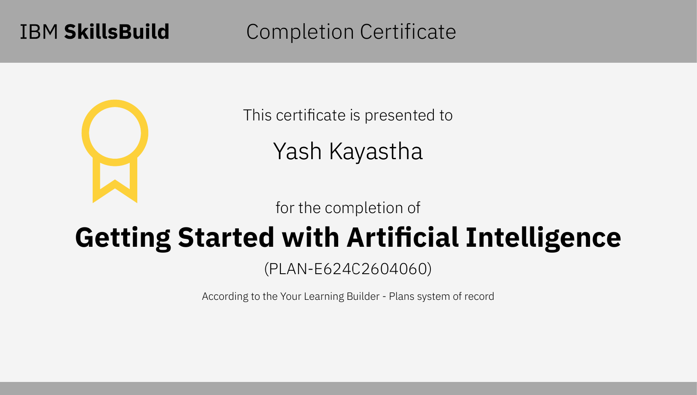

Slide 6
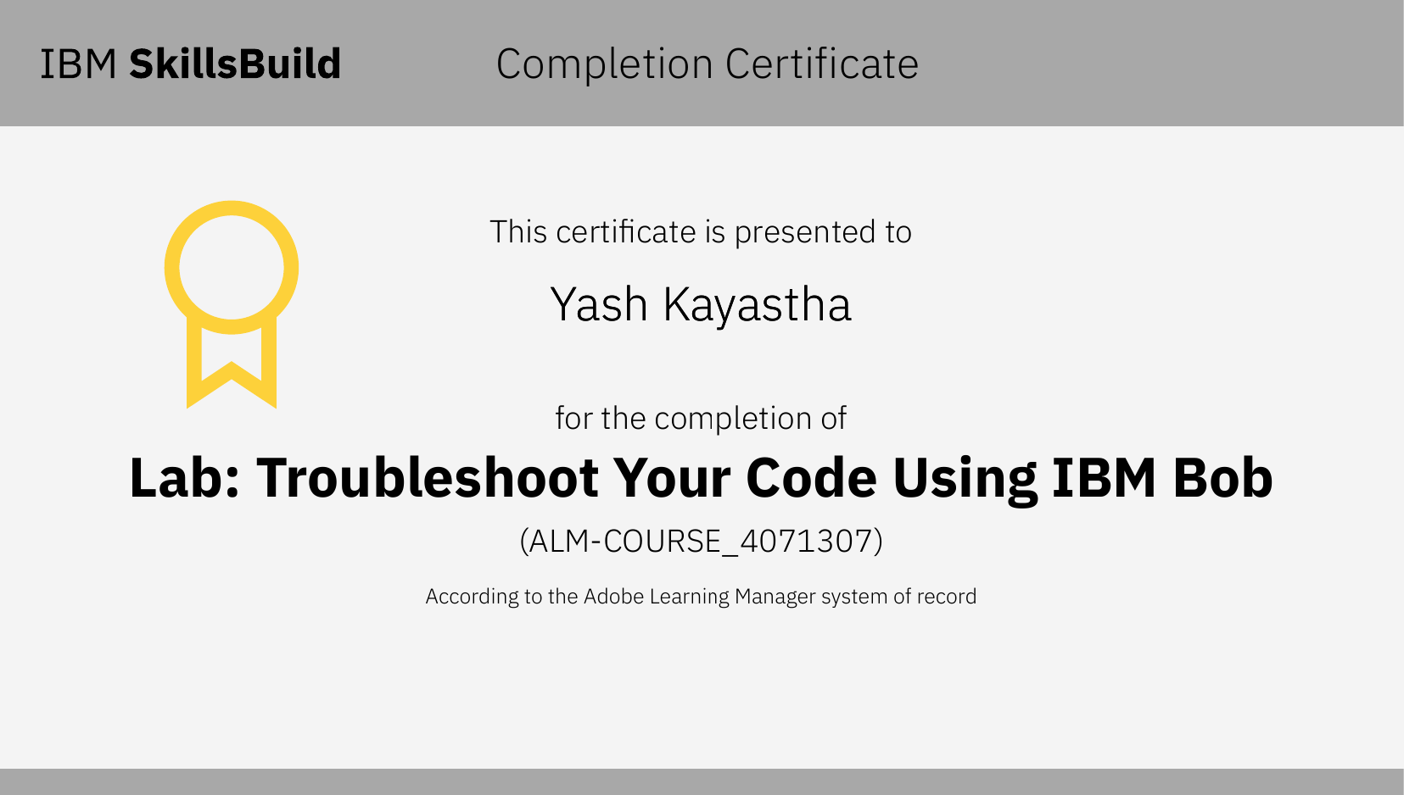

Slide 7

One Intelligent Control Layer for Renewable Energy
GreenPulse AI connects operational signals across assets, weather and grid into a single intelligent platform.

Slide 8
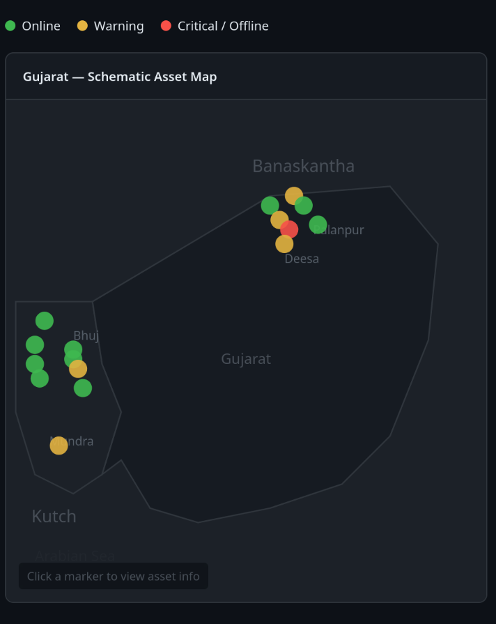
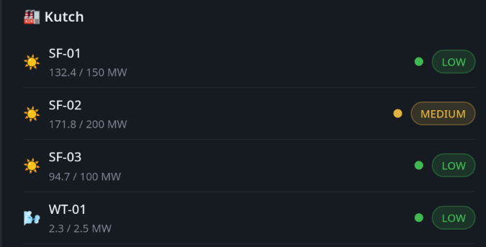

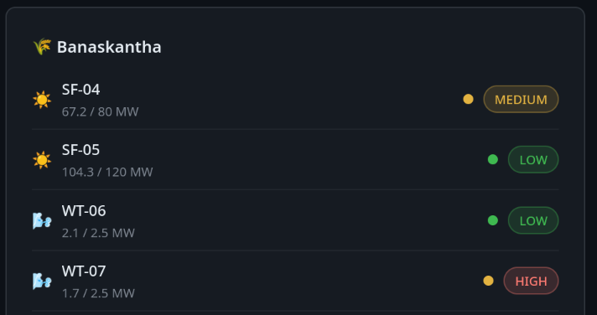
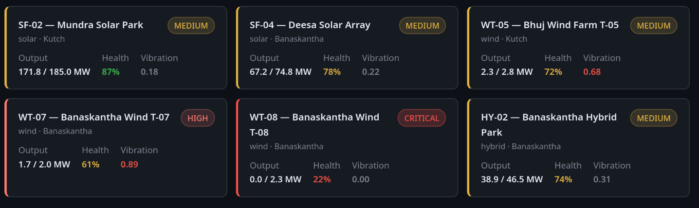
Gujarat, India
The Problem
Renewable Energy Is Growing.
Operational Complexity Is Growing Faster.
Delayed anomaly detection
Manual inspection cycles miss early failures
Weather-driven generation uncertainty
No forecast-to-operations link
Reactive maintenance
Equipment failures drive decisions, not data
Grid integration challenges
Curtailment risk during solar peak hours
No unified operational view across solar,
wind and hybrid assets in the same control layer
Assets → Raw Data → Fragmented Decisions → Lost Generation Value
💰 Every % of curtailment and every missed failure
translates directly to lost generation value

Slide 9
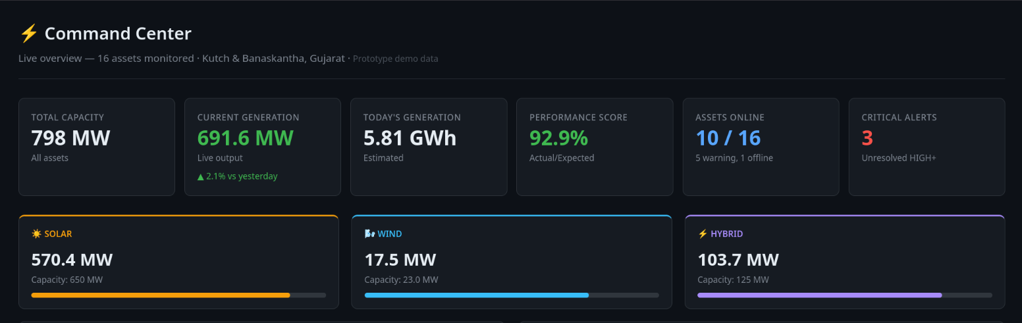
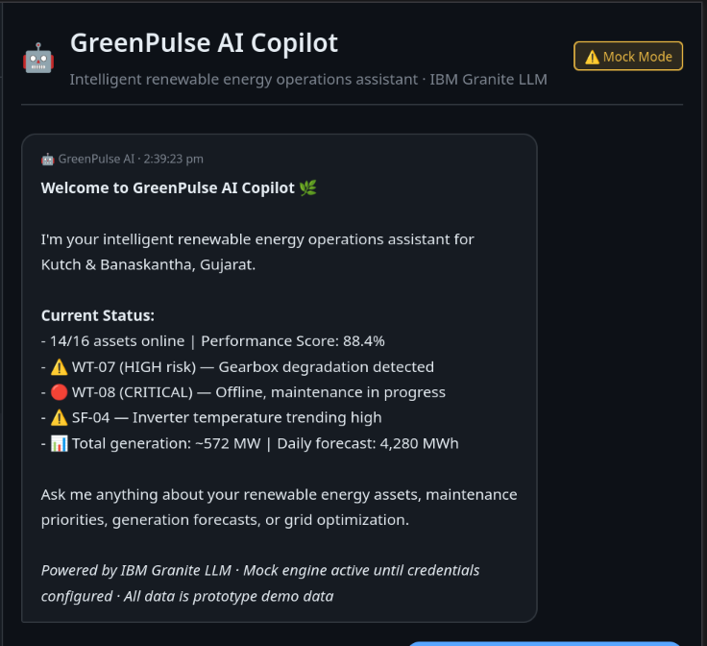
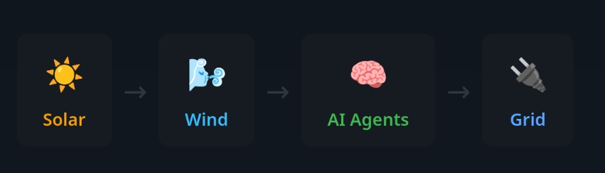
⚡ Command Center | 📡 Assets | 🔧 Maintenance | 📈 Forecast | 🤖 Copilot
The Solution
Agentic AI for Renewable Energy Intelligence
Monitor → Predict → Forecast → Optimize
Smart Renewable Asset Intelligence
Kutch & Banaskantha, Gujarat, India
⚠ Prototype · Demo Data

Slide 10
Agentic AI Architecture
Five Agents. One Coordinated
Energy Intelligence System.
01
02
Asset Performance Agent
Predictive Maintenance Agent
Monitors 16 assets in real time
Detects underperformance & anomalies
Calculates asset health scores
Analyzes vibration, temp & RPM signals
Assigns health scores + failure risk %
Prioritizes maintenance urgency
03
04
05
Generation Forecast Agent
Predictive Maintenance Agent
Dashboard Agent
Predicts solar + wind output
Weather-integrated forecasting
6h · 24h · 7-day horizons
Evaluates export + storage decisions
Detects curtailment risk
Generates real-time grid recommendations
Combines all agent outputs
Powers AI Copilot chat
Generates operator priorities
Drives executive summary

Slide 11
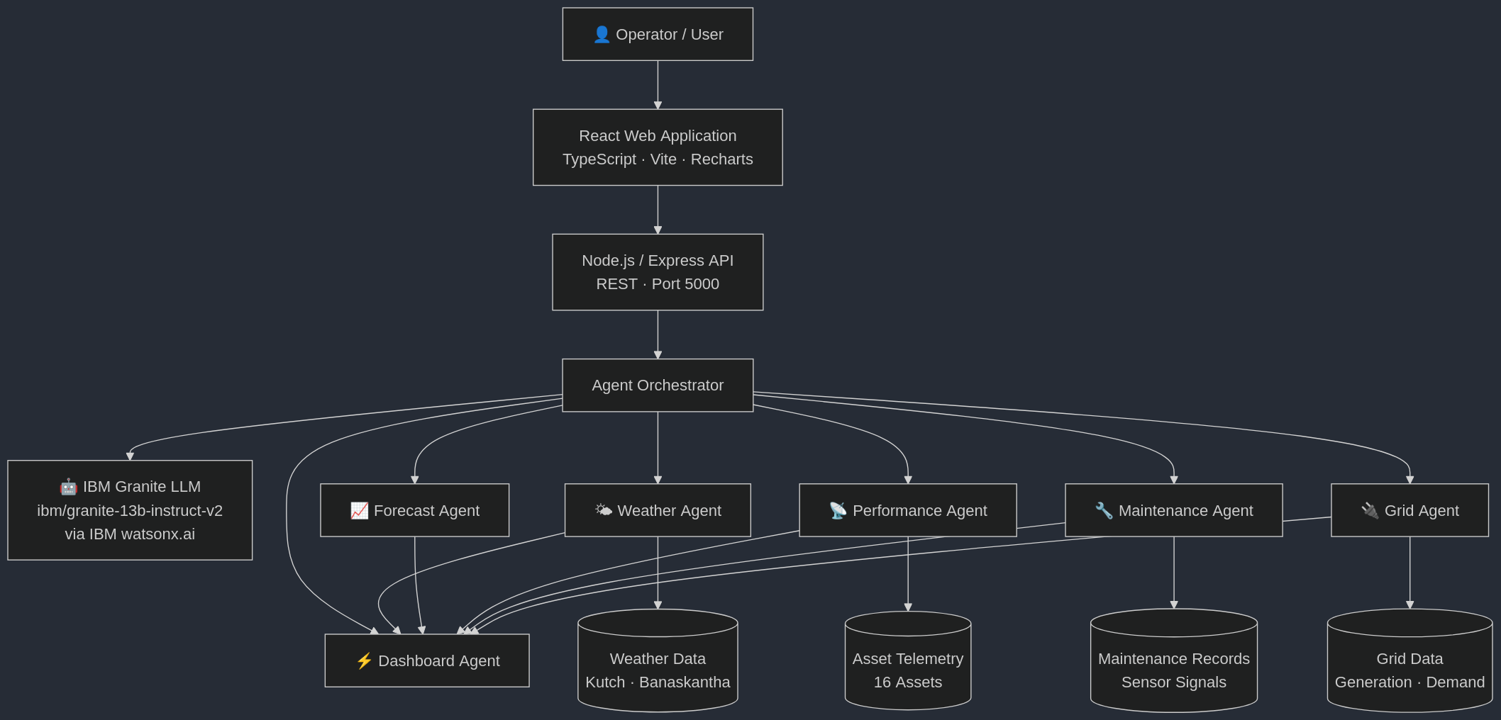

Slide 12
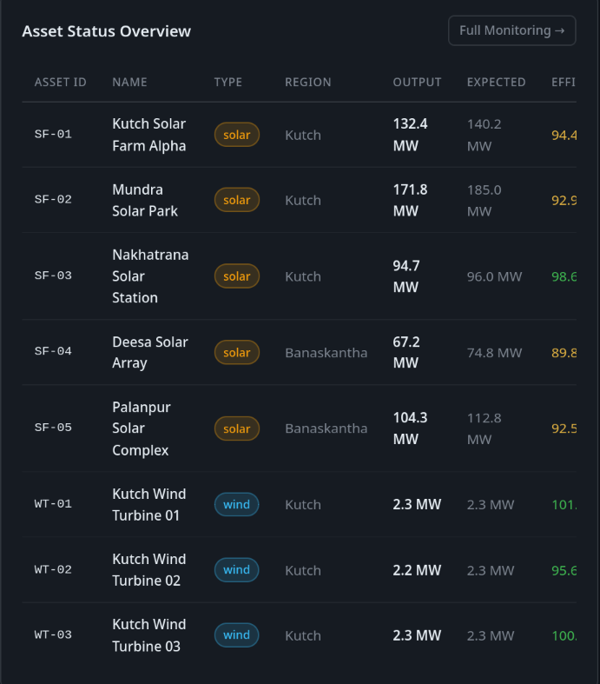
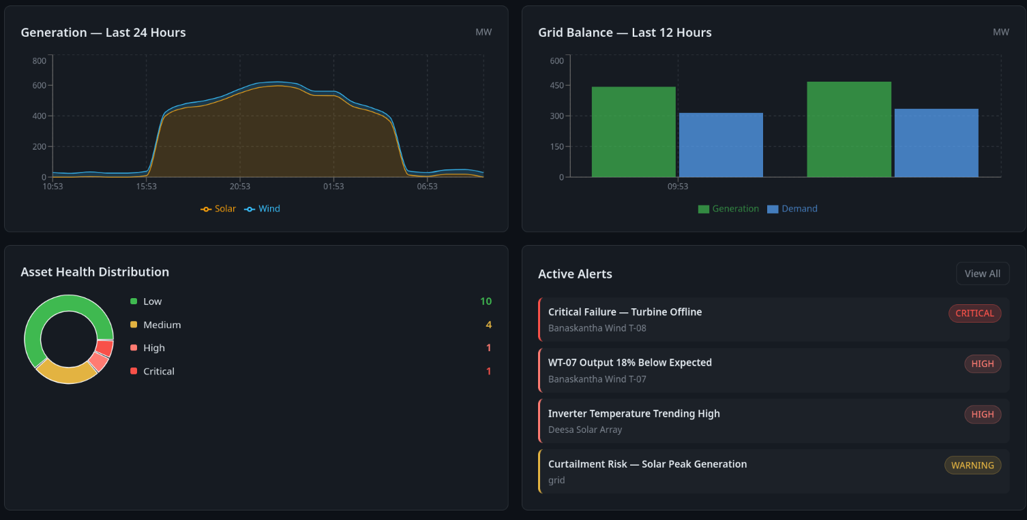
COMMAND CENTER
Everything the Operator Needs.
One Command Center.
A unified operational view across solar, wind and hybrid assets.

Slide 13
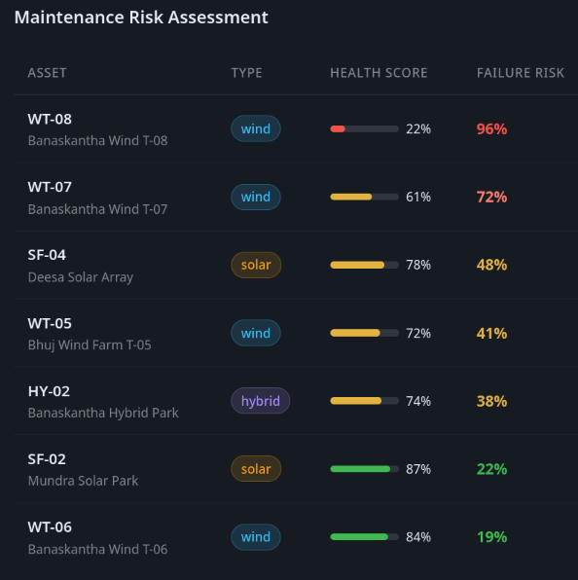
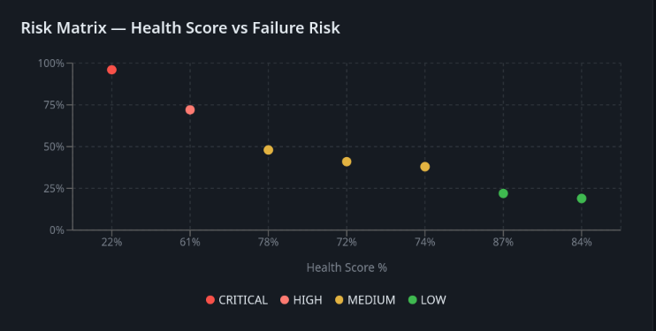
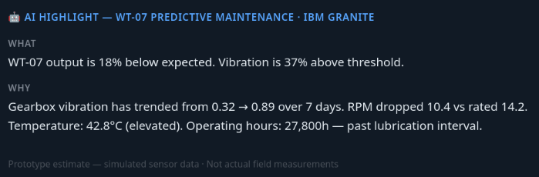
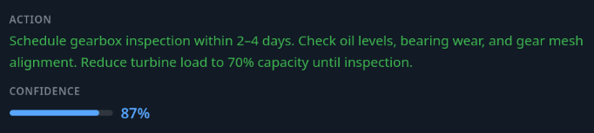
PREDICTIVE MAINTENANCE
Detect Failure Before
It Becomes Downtime

Slide 14
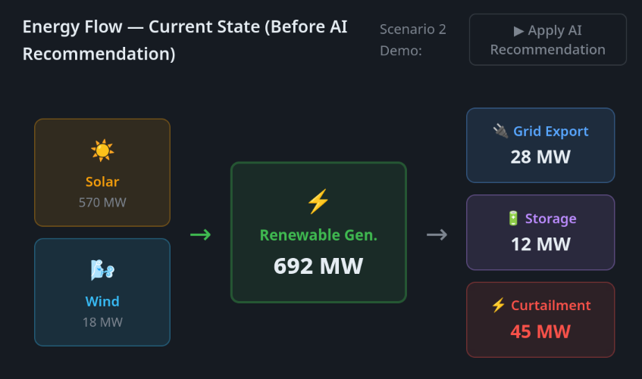
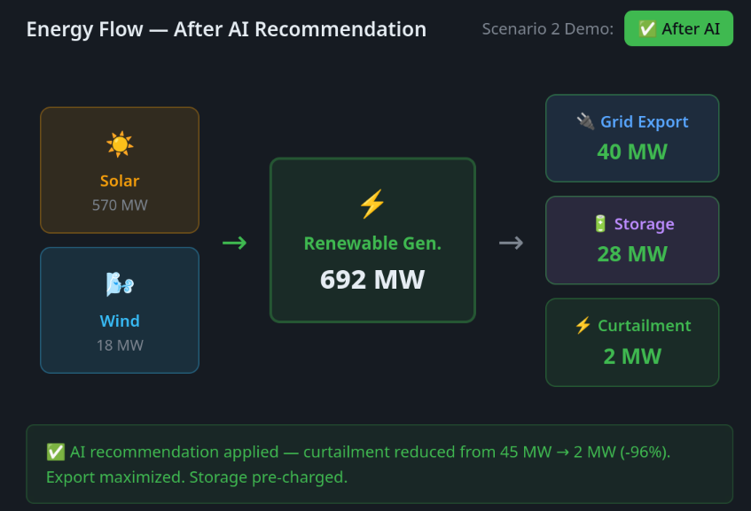
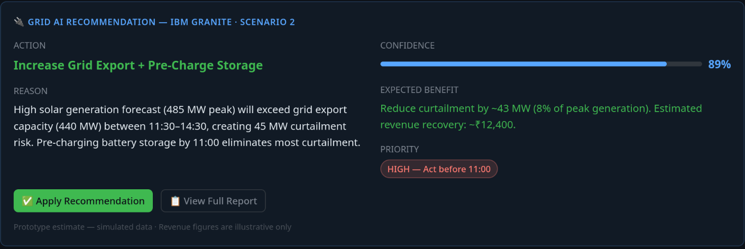
GRID OPTIMIZATION
Turn Renewable Variability
Into a Grid Decision

Slide 15
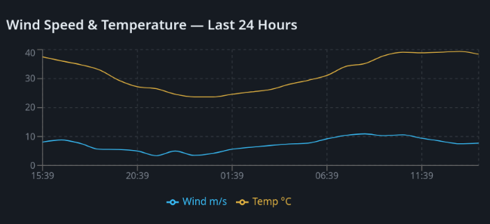
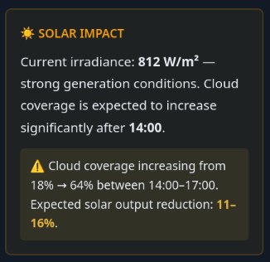
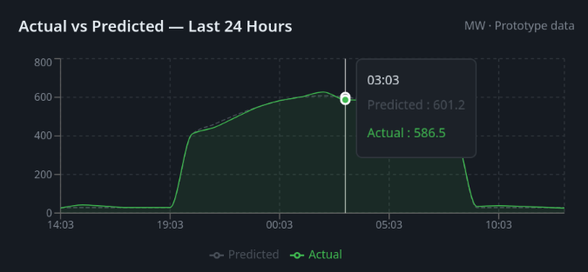
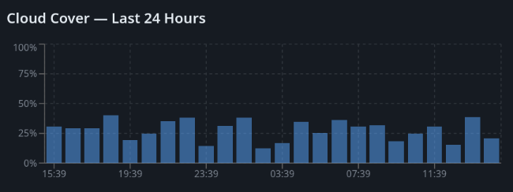
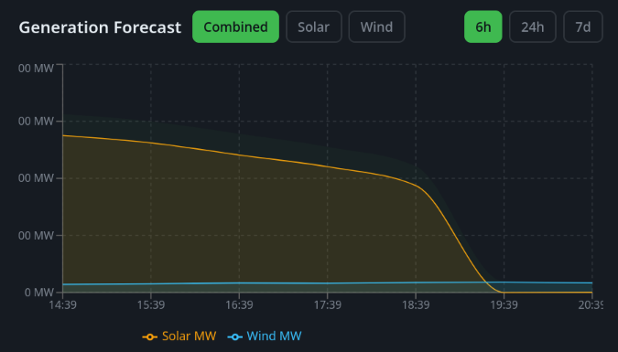
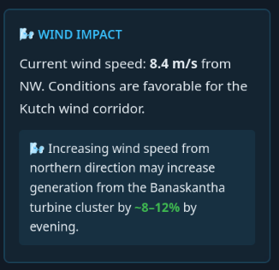
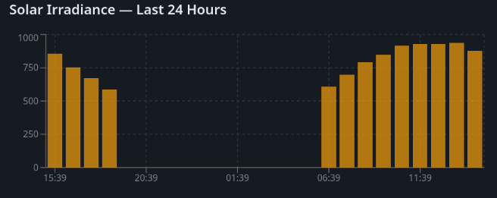
GENERATION FORECAST + WEATHER INTELLIGENCE
Predict Tomorrow's Generation
Before Tomorrow Arrives

Slide 16
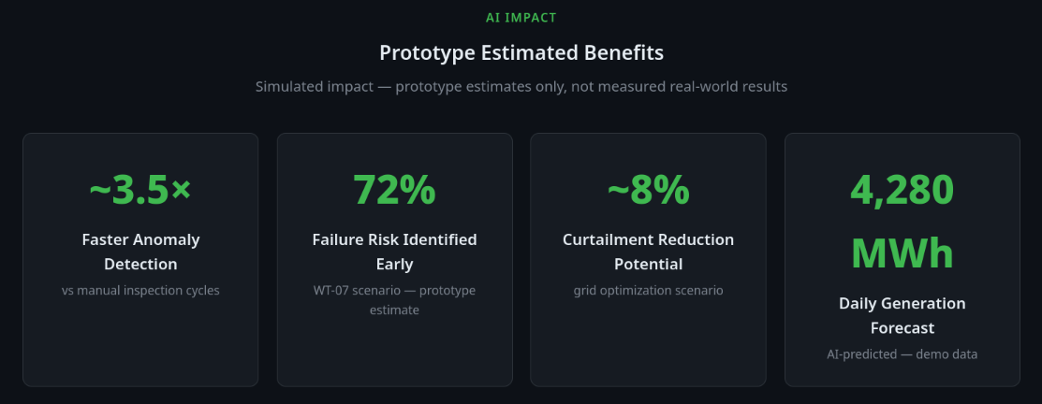
INNOVATION + IMPACT
Why GreenPulse AI Is Different
Multi-Agent Intelligence | Explainable Recommendations
Specialized agents collaborate across weather, forecasting, performance, maintenance and grid domains. Each agent brings focused expertise — not a single model trying to do everything. | Every recommendation shows: WHAT detected → WHY it matters → ACTION to take → CONFIDENCE level Operators and judges understand the AI's value immediately.
Connected Operational Context | IBM Technology Foundation
Asset signals + weather + grid demand + maintenance history combined into one analytical context. GreenPulse AI sees the whole picture, not isolated metrics. | IBM Granite 13B — enterprise-grade LLM for generation + reasoning IBM watsonx.ai — managed model inference IBM Cloud — production-ready deployment Mock fallback — always functional without credentials

Slide 17
FUTURE ROADMAP + CLOSING
From Hackathon Prototype to
Renewable Energy Operations Platform
TODAY
NEXT
SCALE
Hackathon Prototype
Production Deployment
Enterprise Platform
✓ 16 simulated assets
✓ 5 specialized AI agents
✓ IBM Granite integration
✓ Command Center
✓ Predictive maintenance
✓ Generation forecasting
✓ Grid optimization
✓ AI Copilot chat
✓ Agent activity timeline
✓ Alert management
✓ Gujarat schematic map
✓ Architecture page
✓ Demo scenarios
→ Real SCADA integration
→ IoT sensor data streams
→ Live weather APIs
(NASA POWER / ERA5)
→ Digital asset twins
→ Battery optimization
→ Real-time grid APIs
→ Verified GPS maapping
→ Multi-user roles
→ Multi-site portfolio
→ Cross-region intelligence
→ Federated forecasting
→ Autonomous workflows
→ Carbon tracking
→ Grid operator APIs
→ Utility-scale
deployment
→ Real-time markets
→
→
Conclusion
GreenPulse AI uses Agentic AI and IBM Granite to monitor renewable assets, predict maintenance needs, forecast generation, and optimize grid decisions. It provides a smart, unified platform for more efficient and sustainable renewable-energy management.

Slide 18

Thank You !
Source Code: https://github.com/kyt47000/GreenPulse-AI
Documentation: https://github.com/kyt47000/GreenPulse-AI/blob/main/README.md
Demo: https://kyt47000.github.io/GreenPulse-AI/

